Slide 1
J&J – Akrivia Health SomaLogic Proteomics Analysis: Kickoff Meeting
Kevin Blighe, PhD, Bioinformatics
Julie Segueni, PhD, Bioinformatics
Corey Oravetz, CSM, Project Manager
Shahraz Niwaz, Business Account Manager
Kickoff Meeting
2026-Feb-03

Slide 2
Agenda

Slide 3
Agenda
Meet the Team Team introductions
Project Background, Scope & Summary Review & finalize the project background & objectives, scope, deliverables, and timeline
Questions & Discussion
Project Cadence & Sharing Communications, Meetings & Doc/Data Sharing

Slide 4
Meeting Minutes & Action Items

Slide 5
Minutes from 2026-Feb-02 Meeting
Introductions:
Team: Introductions to the Bioinformatics Team from Rancho, with Shahraz joining as the Business Account Manager (taking over from Julie Bryant). Introductions were done for Farzad and Joe from the Neuro J&J Team.
Background/Scope:
Kevin: Reviewed the project background that involves analyzing a larger dataset of proteomics data using Somologic platform (from prior work that Rancho did with the Akrivia data)
Joe: Clarified the subjects are primarily neuropsychiatric disorders rather than neurodegeneration and contains no healthy controls.
Kevin: Data analysis will involve correlating proteomics data with clinical data once everything is prepared, with the team working together to define each condition and group of interest for comparison.
Kevin: Initial analysis will focus purely on proteomic data while ignoring genetic data for now, with pQTL analysis planned for later projects.
Kevin: Onboarding steps will be expedited since Julie already has a J&J account and email address, and both Julie and Kevin are already using the Domino environment which is ideal for this project.
Kevin: Analysis workflow will include data retrieval, normalization and QC of Somologic data, differential abundance analysis followed by pathway analysis to find both shared pathways across different conditions and unique ones.
Kevin: Project scope includes 104 hours of work which translates to approximately 1-1.5-month timeline, with Julie splitting time between this and other J&J projects at roughly 20-30% allocation.
Joe: Asked about and shared the need for a delivery deadline ahead of May, which should provide sufficient time for completion, with flexibility for iterative analysis processes that may extend beyond the initial hour estimate.

Slide 6
Minutes from 2026-Feb-02 Meeting
Compute Environment and Data Access
Team: Data transfer of the Akrivia logistics were discussed, with the current dataset consisting of just two ADT files at about 40MB each stored in a Teams folder, which can be easily imported directly into Domino without requiring an S3 bucket.
Farzad: Confirmed he can create a new Domino project for the team and move the files into the environment, with Julie being added as a collaborator to access the data.
Joe: Shared that the clinical phenotype data exists in a separate Excel spreadsheet with linkers that will need to be integrated with the proteomics data for comprehensive analysis. Joe would investigate granting access to Julie and Kevin.
Next Steps & Meeting Cadence
Corey/Joe: Confirmed a weekly 30-minute meeting would be calendared as a regular cadence for project updates, with flexibility to cancel if no updates are needed and openness for ad-hoc communication throughout the week.

Slide 7
Action Items
Action Items from 2026-Feb-03 Meeting
Joe: Provide access to the MS Teams folder containing the Akrivia clinical XLS files – IN PROGRESS
Farzad: Create a new Domino project and upload the proteomics data files for the analysis – IN PROGRESS
Corey: Setup weekly calendar cadence for the team to meet – COMPLETE, 2026-Feb-03

Slide 8
Rancho Team

Slide 9


Kevin Blighe, PhD
PERSONAL PROFILE
Irish Biostar
>10 years of experience applying bioinformatics methods to a wide range of disease areas
ACHIEVEMENTS
WORK EXPERIENCE
30+ publications; h-index, 17; i10, 21
Awards
RANCHO BIOSCIENCES
Honorary Visiting Professor
Research Fellowship
Excellent Ph.D. Performance
Seminar Day presentation prize
Bursary
Student of the Year (x2)
Independent contractor with Rancho since January 2019
European Commission
Expert grant reviewer
EDUCATION
Clinical Bioinformatics Research Ltd.
Postdoc
Brigham & Women's Hospital, UCL, King's College London, QMUL
London-based bioinformatics CRO
Ph.D. Breast Cancer genetics
NHS England
University of Leicester, UK
Lead Bioinformatician
B.Sc. (hons.) Industrial Biology
IT Carlow, Ireland
SKILLS & LANGUAGES
Computer Science
TU Dublin, Ireland
Skills
CONTACT INFO
NGS & Microarray analysis; Biostatistics
Programming / Scripting languages
EMAIL
R, JAVA, shell scripting
kevin.blighe@ranchobiosciences.com
Languages
English, Portuguese, Spanish

Slide 10
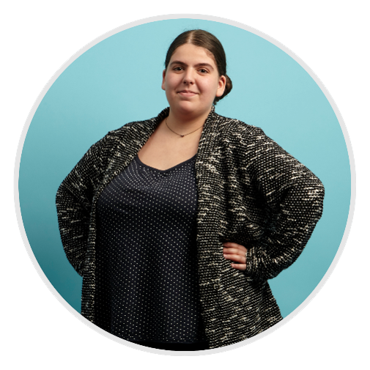
Julie Segueni, PhD – Bioinformatician
PERSONAL PROFILE
City/State
Versailles, France
WORK EXPERIENCE
ACHIEVEMENTS
PAPERS – CERTIFICATES
Publication: DOI: 10.1016/j.csbj.2022.05.044
FAIR practices certificate
RANCHO BIOSCIENCES
Bioinformatician specialized in genomics analyses
EDUCATION
I2BC – CNRS – Université Paris-Saclay
Bioinformatician in multiple projects, pipeline design and implementation, tool development, multi-omics data integration
DEGREE
Master's degree from ENS Paris
PhD degree from Université Paris-Saclay
SKILLS & LANGUAGES
SKILLS
ChIP-seq analysis, RNA-seq analysis, DNA methylation analysis, Variant calling analysis, Chromatin state analysis (ChromHMM), Short and long read sequencing
LANGUAGES
Native French speaker and fluent in English
CONTACT INFO
EMAIL
julie.segueni@ranchobiosciences.com

Slide 11
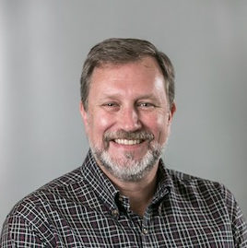

Corey Oravetz, Project Manager
PERSONAL PROFILE
Portland, OR
30+ years of experience in Pharma – R&D (Clinical Ops, Regulatory, Data Science), DIA, & IT
ACHIEVEMENTS
WORK EXPERIENCE
CERTIFICATES Scrum Master, Product Owner - Scrum Alliance Core Design & ML Practitioner - Dataiku LoadRunner, WinRunner, QTP, Test Director
RANCHO BIOSCIENCES
Project Manager
EDUCATION
DEGREE
Biochemistry w/some graduate work in Enzyme Kinetics, University of California (UC), Davis
Genentech/Roche (25+ yrs)
People & Product Leader, System Owner/Project Manager, Head of Regulatory Systems, IT Systems Manager, SQA Manager
Intermune
IT Project Manager, eTMF Specialist
SKILLS & LANGUAGES
Start-up/Innovator
Co-Founder of Magnet Me.AI Advisor for startups: Infinote and Silicon Valley Micro Service Web & Software Development for various Silicon Valley companies 3D Printing and prototyping - various industries
CONTACT INFO
EMAIL & PHONE
corey.oravetz@ranchobiosciences.com
Phone number: 503-919-1030

Slide 12
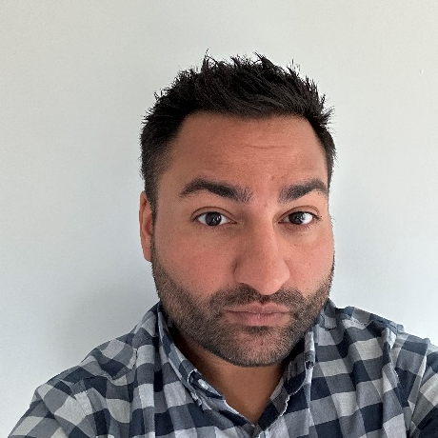
Shahraz Niwaz, Business Account Manager
PERSONAL PROFILE
An experienced Commercial Executive with over 10 years of experience supporting clients from Discovery through Commercialization in the Life Sciences and Biopharmaceutical Industries
WORK EXPERIENCE
ACHIEVEMENTS
RANCHO BIOSCIENCES
Business Account Manager
Publications
Tempus Labs
Diabetes Research published in Atherosclerosis
Senior Alliance Manager
EvaluatePharma
Sr Director – Consulting & Analytics
EDUCATION
Clarivate
Questrom School of Business, Boston University
Global Commercial Services Director
Thomson Reuters
MBA
Sales Manager, Systems Biology EMEA
University of Birmingham
BSc (Hons) Biochemistry
MSc Toxicology
SKILLS & LANGUAGES
Languages
CONTACT INFO
English, Urdu, Hindi, Punjabi
French (Conversational)
Skills
EMAIL & CELL shahraz.niwaz@ranchobiosciences.com
267-207-0102
Proficient in many laboratory techniques and leveraging and harmonizing disparate data sources

Slide 13
J&J - Introductions
Placeholder for J&J Introductions Joe Pick Farzad Vasheghani
Notes:
Do they already have a template in mind?

Slide 14
Project Overview

Slide 15
J&J: Akrivia Health SomaLogic Proteomics Analysis Background & Objectives
Background Utilize data from Akrivia Health to investigate overlapping and unique biological pathways across Schizophrenia, Bipolar Disorder, Dementia, and Alzheimer's Disease.
The study involves 465 samples analyzed via the SomaLogic 11k platform and sequencing for approximately 1,000 samples.
Key objectives include:
Comparing treatment-resistant conditions (such as Alzheimer's) against responsive ones based on observed symptoms rather than self-reports
Correlating proteomic levels with clinical data
Performing pQTL analysis to link genetic variants to protein expression.
Note:
Note: analysis of the WGS data and pQTL is not in scope for this initial project.

Slide 16
J&J: Akrivia Health SomaLogic Proteomics Analysis Scope
On-Boarding
Client initiates on-boarding to create collaborator account
Complete mandatory training to use client’s systems
On-boarding to J&J Domino environment
Data Retrieval, Normalization, & QC
QC and normalization of data via SomaDataIO R package
Unsupervised clustering and PCA
Align expression-level data with available clinical / phenotype data
Differential Abundance Analysis (DAA)
Liaising with the client, define different analysis groups based on symptoms, not self-report only
Perform DAA across analysis groups (pairwise comparisons or ANOVA, where appropriate).
Pathway Analyis
Determine involved pathways and gene signatures from DAA results tables
Gauge overlapping pathways across diseases / analysis groups, plus unique involved pathways

Slide 17
J&J: Akrivia Health SomaLogic Proteomics Analysis Scope
Compare treatment-resistant patients vs responders
Perform differential analysis to define candidate proteins involved in resistance / response
Correlate proteomics levels to clinical data
Perform Pearson or Spearman correlation or linear regression to define proteins whose expression correlates with clinical / phenotype parameters
Reporting & QC
Produce PowerPoint to summarize all findings.
Overall independent QC

Slide 18
J&J: Akrivia Health SomaLogic Proteomics Analysis Deliverables & Timeline
Deliverables
Graphical and tabular outputs for all results
Code used to perform analysis
Timeline
On-Boarding (4 hours)
Data Retrieval, Normalization, & QC (16 hours)
Differential Abundance Analysis (DAA) (24 hours)
Pathway Analyis (24 hours)
Compare treatment-resistant patients vs responders (16 hours)
Correlate proteomics levels to clinical data (12 hours)
Reporting & QC (8 hours)
Total: 104 hours Bioinformatics; 10 hours Project Management.

Slide 19
Discussion/Questions
Placeholder for Q&A, Discussion, Next Steps
Notes:
Do they already have a template in mind?

Slide 20
Communication and Contacts

Slide 21
Communication
Agree and schedule regular check-in meetings
Weekly?
Meeting and communication platform
JnJ/Rancho - Emails
Data Delivery - Domino
Document Delivery – Email, other share/location?

Slide 22
THANK YOU

